Slide 1

Home Page

Slide 2
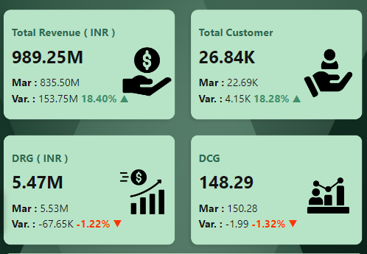
1. General Overview
The dashboard provides a comprehensive view of key metrics related to insurance sales, customer demographics, and other critical insights. It is designed to help stakeholders make informed decisions based on data-driven insights.
KPI Card Representation:
Green Font with Upward Arrow (↑): Indicates an increase in percentage change.
Red Font with Downward Arrow (↓): Indicates a decrease in percentage change.

Slide 3


2. Navigation
Right-Headed Arrow: The right-headed arrow visible on the General View, Sales Mode Analysis, and Age Group Analysis slides serves as the navigation pane open button. Clicking on this arrow will expand the navigation pane, allowing users to access different sections of the dashboard easily.
Clear Filter Button: The dashboard includes a "Clear Filter" button that allows users to reset all applied filters, ensuring they can easily return to the default view without manually deselecting each filter.

Slide 4
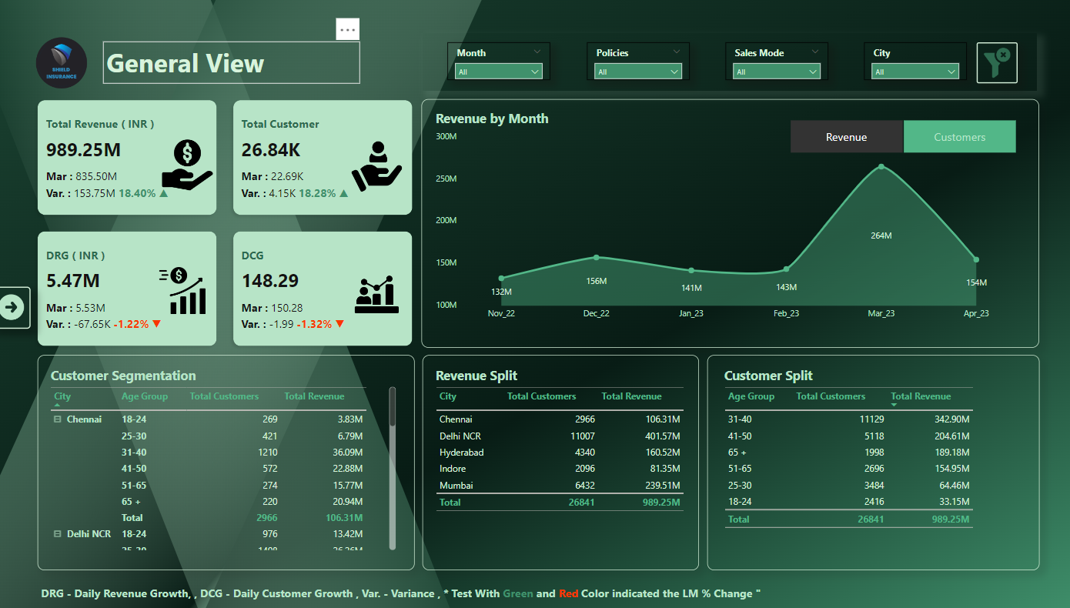
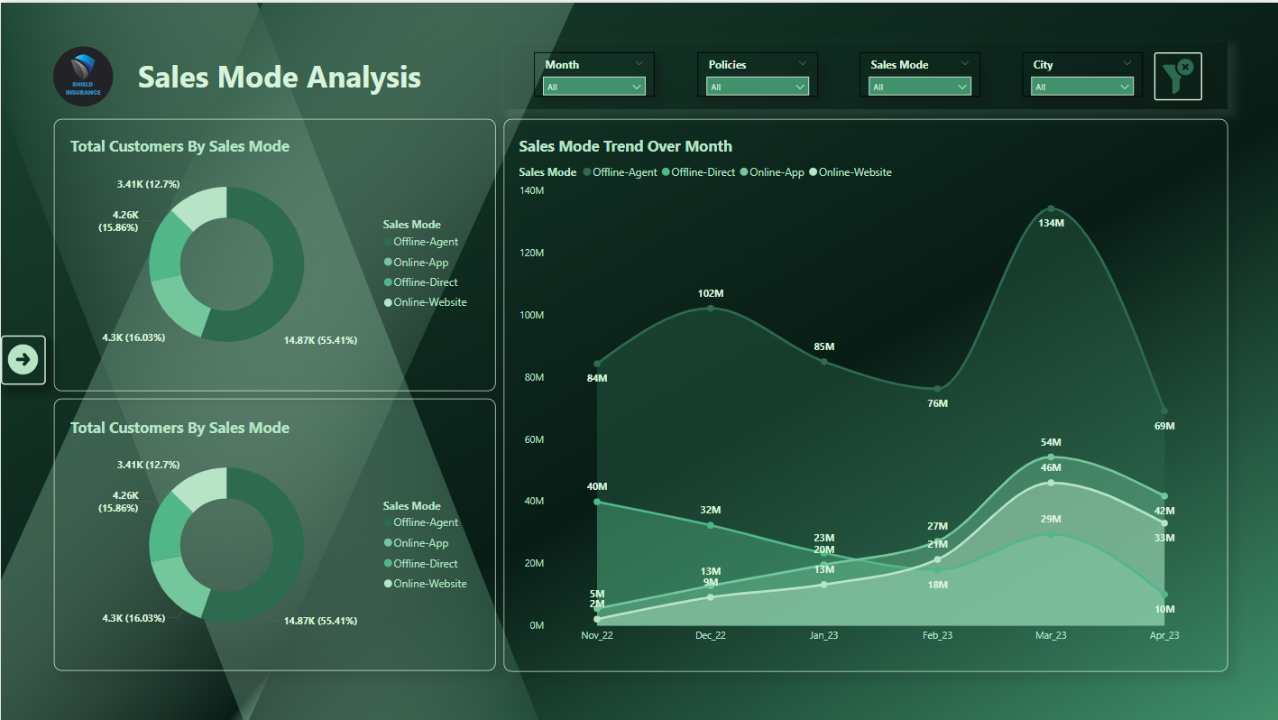
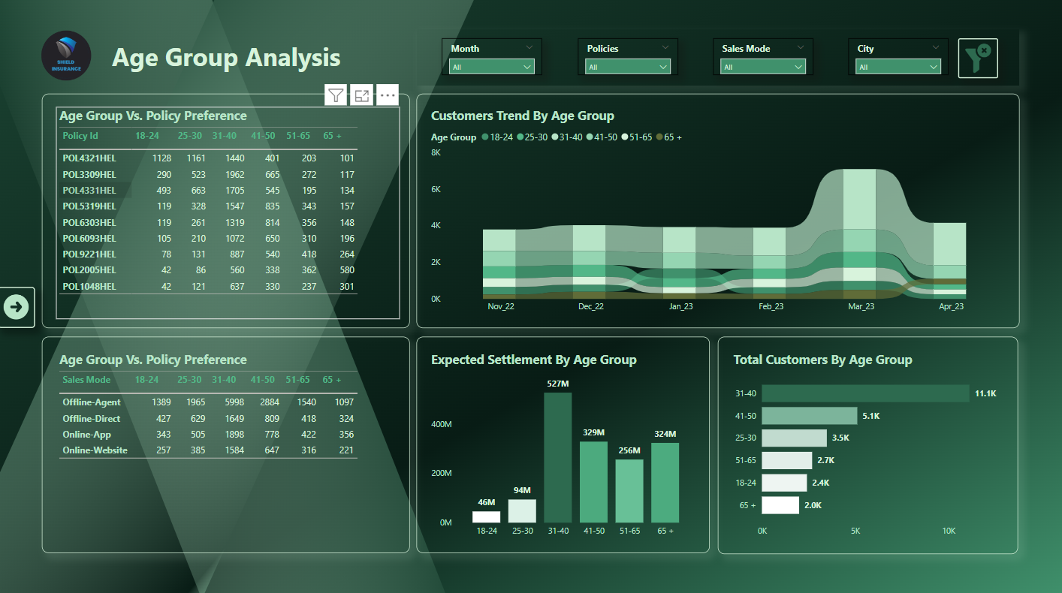
3. Key Sections
General View: This section provides a summary of overall insurance sales, highlighting key performance indicators and trends over time.
Sales Mode Analysis: This section breaks down the sales data by different modes of sales, such as online, agent-driven, or direct. It offers insights into the effectiveness of each sales channel.
Age Group Analysis: This section analyzes the customer demographics by age group, showing how different age groups contribute to the overall insurance sales and customer base.

Slide 5
4. Interactivity
The dashboard is interactive, allowing users to filter and drill down into specific data points for a more detailed analysis. Users can interact with the different visual elements to gain deeper insights into the data.

Slide 6
5. Usage Tips
Make sure to utilize the navigation pane for easy access to various sections of the dashboard.
Hover over data points for more detailed information and additional insights.

